Slide 1
PALMORIA MANUFACTURING GROUP NIGERIA
EMPLOYEE ANALYSIS

Slide 2
Here is an insight of employee performance for Palmoria Manufacturing Group, Nigeria.
Number Of Employee’s: This firm, with 874 employees, is a mid-sized company with moderate operational capacity and a diverse structure. It requires a strong management hierarchy and face challenges in maintaining culture and communication. The employee count suggests potential for growth.
Departments: With 12 departments, the firm likely has a streamlined and efficient organizational structure. This setup balances specialization with operational needs, requiring effective management and coordination. It supports efficient communication and resource allocation while allowing room for growth and adjustment as needed.
Salary: The total salary of $69.54 million for 874 employees implies an average salary of about $79,700. This significant payroll expense reflects the firm's investment in employee compensation and can be used to benchmark against industry standards, assess financial health, and evaluate the impact on profitability.
Region: The region slicer with a drop-down menu allows users to easily filter and analyze data by state. It enhances usability, provides focused regional insights, and supports dynamic and interactive reporting.
Department: The department slicer with a drop-down menu improves data filtering and reporting by allowing users to easily focus on specific departments. It simplifies navigation, enhances usability, and supports customized analyses of departmental information.
Employee By Gender: The gender distribution of 464 male, 440 female, and 39 non-binary shows a balanced representation with a commitment to inclusivity. It reflects diversity within the workforce and can inform policies related to gender equity and workplace culture.
Average Salary By Gender: The average salaries show that non-binary employees earn the highest average, followed by males and females. This indicates potential pay disparities that may need to be addressed to ensure fair and equitable compensation across all gender identities.
Ratings By Gender: Non-binary employees generally have higher satisfaction with more "very good" ratings and fewer negative ratings. Males show higher percentages of "poor" and "very poor" ratings, suggesting a need for improvement. Females exhibit balanced satisfaction with high ratings and fewer extreme negatives.

Slide 3
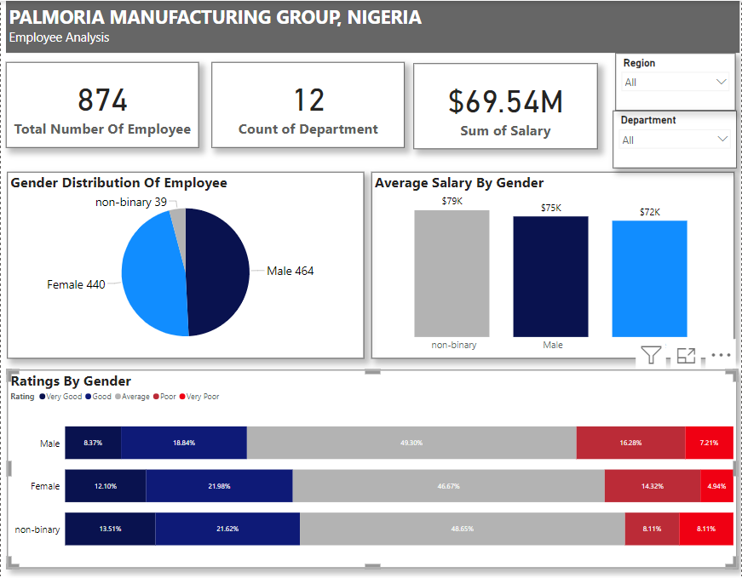
PALMORIA MANUFACTURNG GROUP EMPLOYEE ANALYSIS DASHBOARD

